Slide 1
Bayesian assignment
Statistical solutions to research problems in psychology
Lecture 2
Rik Huijzer

Slide 2
My background
Computer science
Now PhD in psychology
Prefer Bayesian
Write blog posts (some lecture content is from my blog)

Slide 3
This lecture
Recap lecture 1
Break
Bayesian assignment

Slide 4
Recap lecture 1
Slightly different angle:
generalize if you already got it last week
everything falls into place otherwise

Slide 5
What is parameter estimation again?
From a sample, estimate population parameters.
given n lengths of Dutch people, what is the height of the Dutch population?
given n participants personality scores, what is the population score?
given the widths of n produced buckets in a factory, what is the width produced by the machine?
This is the foundation for statistical tests such as t-tests or Bayes factors

Slide 6
Why do we simulate data again?
"We generated fake data"
- "Fake? As in fake news?"

Slide 7
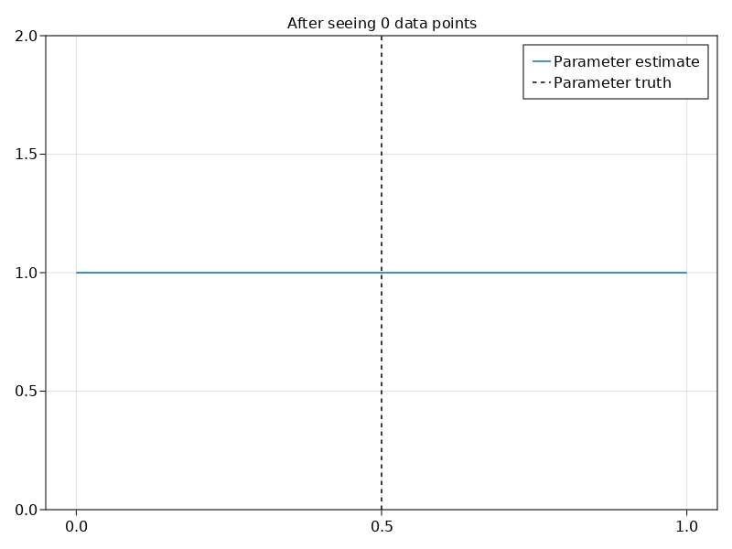

Slide 8
Bayes' theorem
posterior belief ∝ likelihood × prior belief
Or, even simpler:
prior × data = posterior

Slide 9
Today's posterior is tomorrow's prior

Slide 11
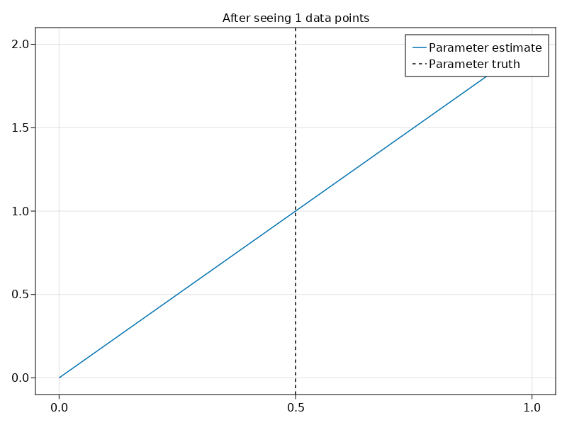

Slide 12
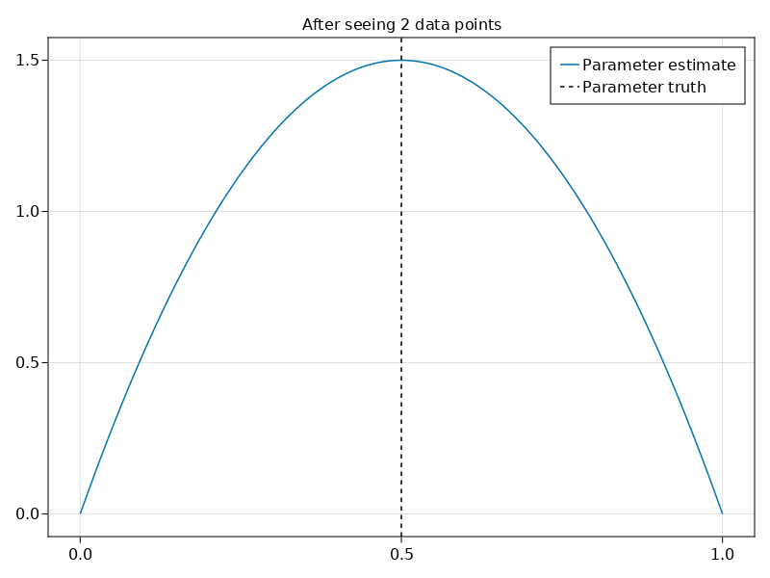

Slide 13
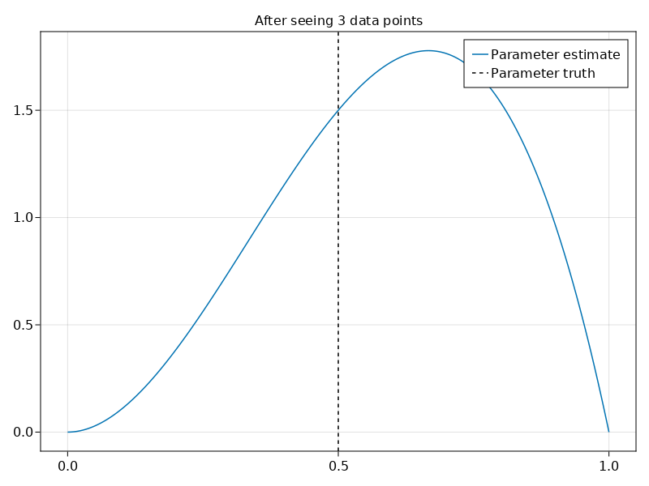

Slide 14
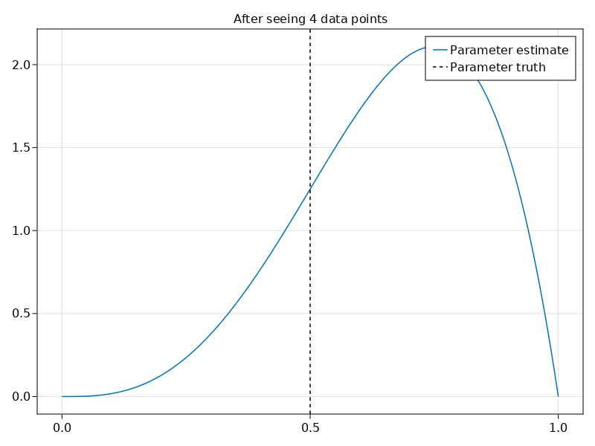

Slide 15
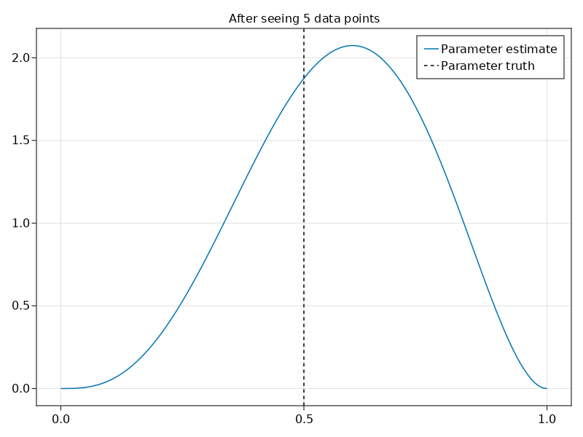

Slide 16
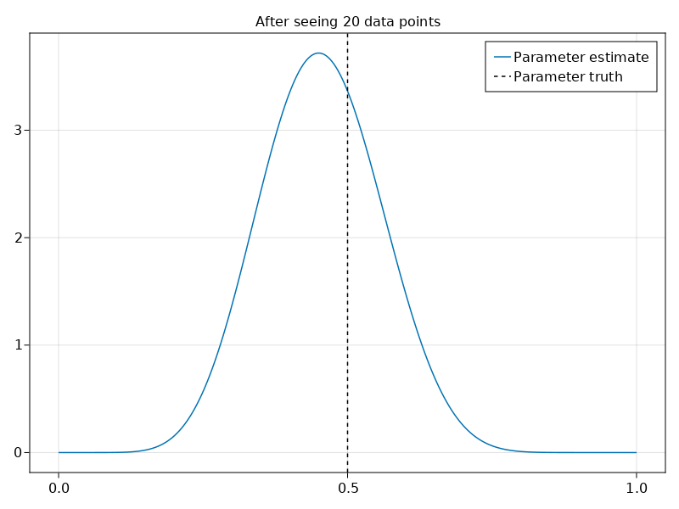

Slide 17
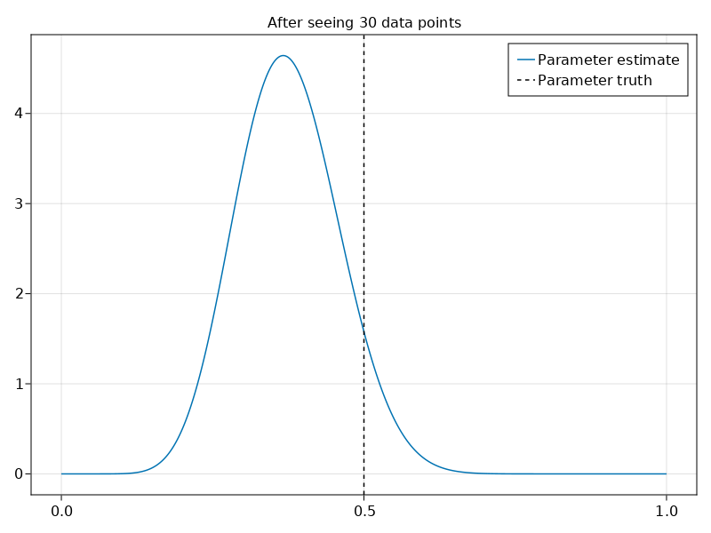

Slide 18
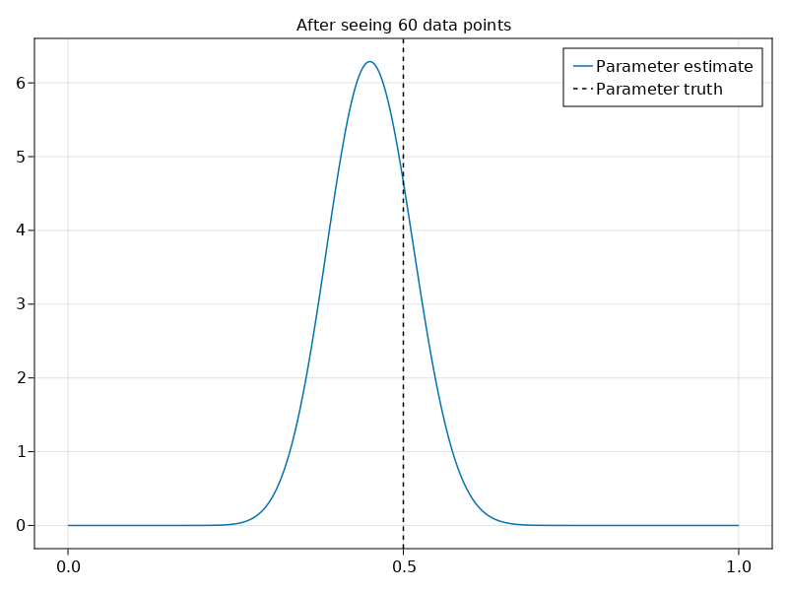

Slide 19
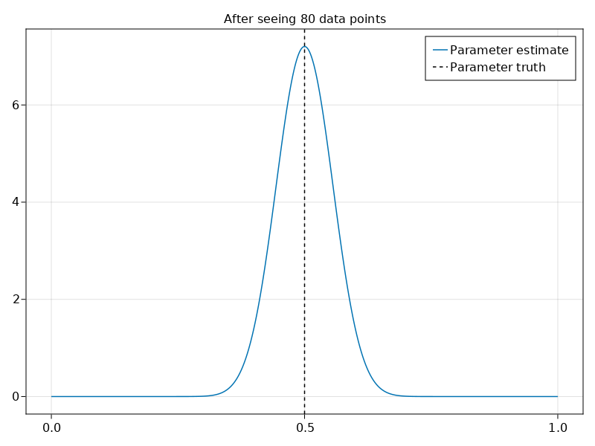

Slide 20
How would this look in the frequentist world?

Slide 21
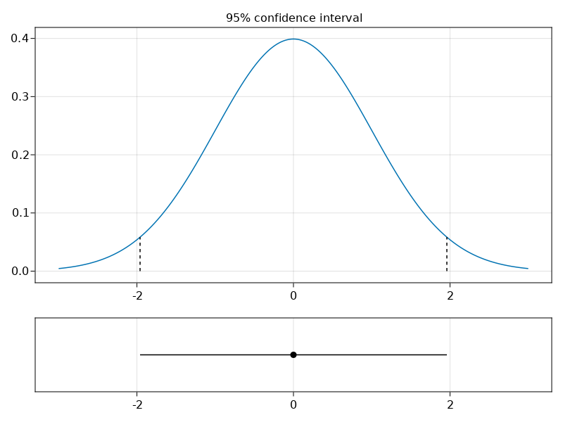

Slide 22
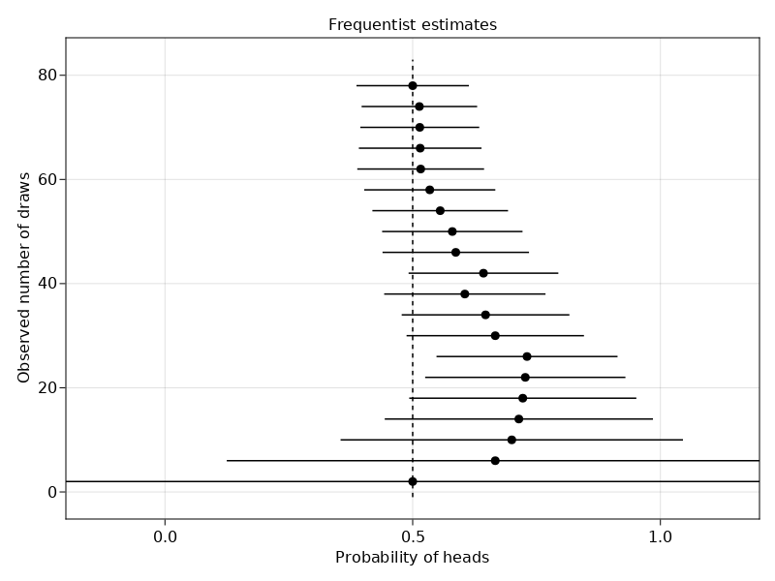
https://huijzer.xyz/posts/frequentist-bayesian-coin-flipping/

Slide 23
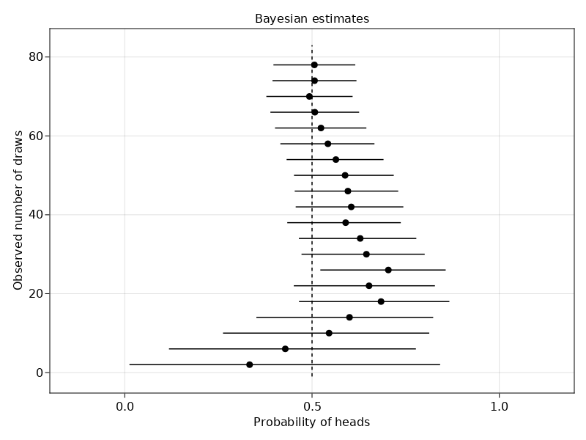

Slide 24
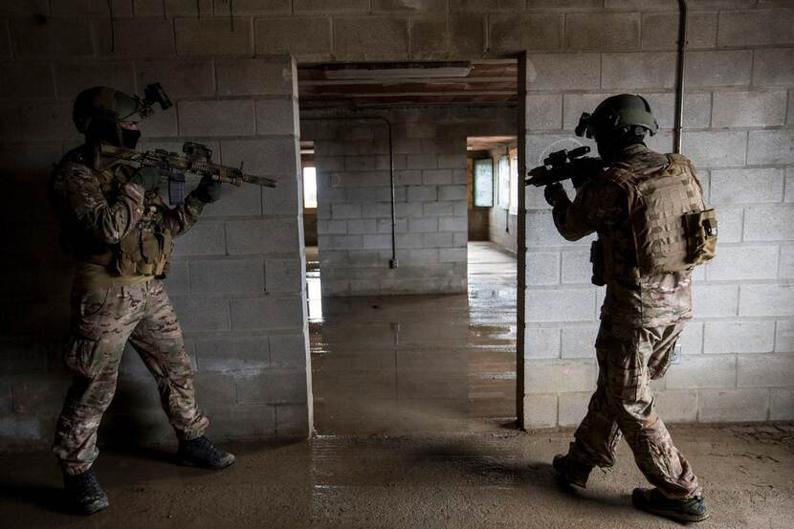
PhD project
Special forces (commandos)
Predict graduation
Questionnaires
Personality
source: Defensie.nl

Slide 25
Bayesian versus frequentist linear regression
Simulated data for special forces selection
Dropout (0.0) --- Graduate (1.0)
Number of participants: ~150
Number of questionnaires: 5 in the simulated data (>20 in reality)
Questionnaire names: A, B, C, D and E
Outcome/dependent variable: Y
High correlations
Centered and standardized data (to compare different questionnaires)

Slide 26
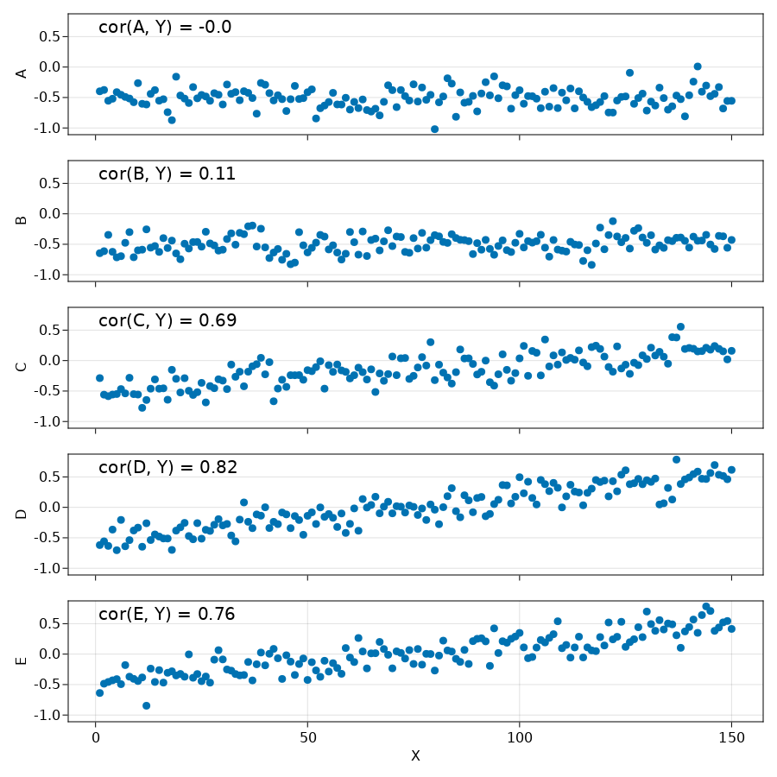
NB. Centered and standardized data
https://huijzer.xyz/posts/collinear-bayes/

Slide 27
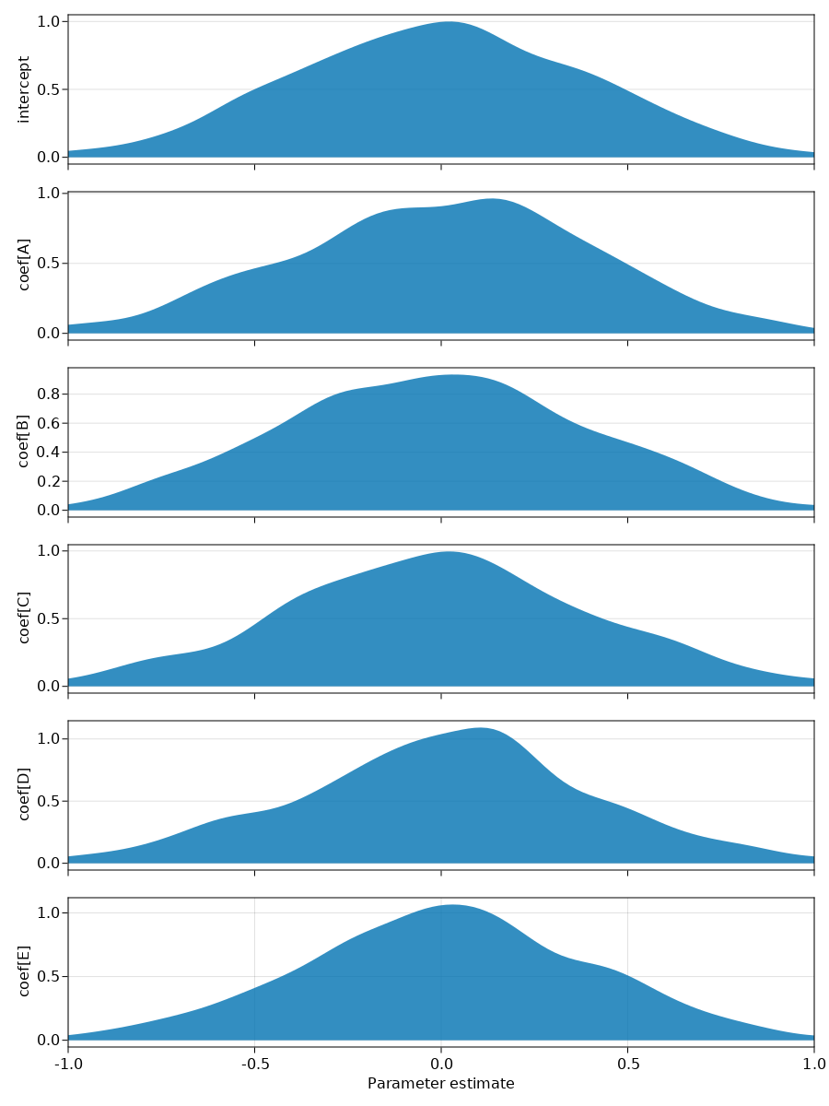

Slide 28
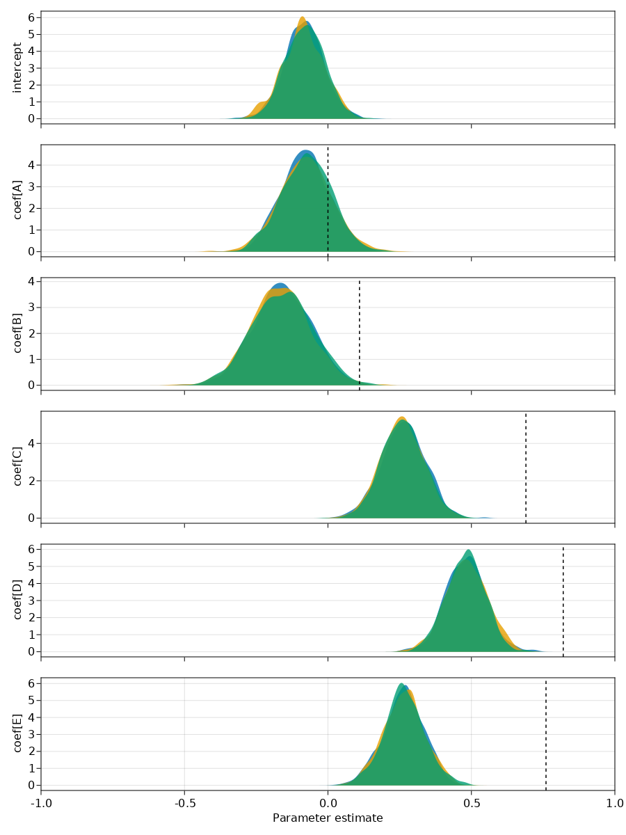

Slide 29
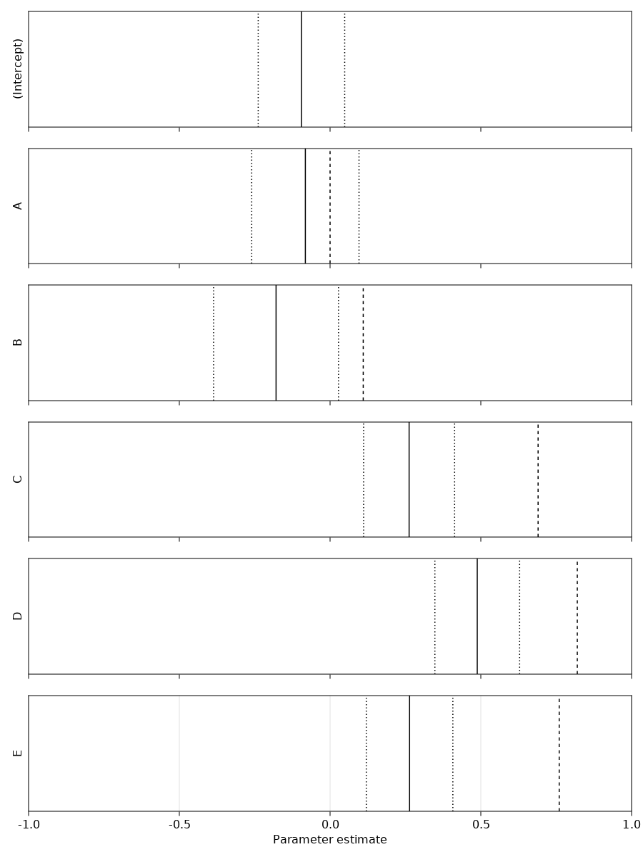

Slide 30
Takeaways
Many things possible
Given the same data, frequentist and Bayesian statistics will often yield the same conclusions

Slide 31
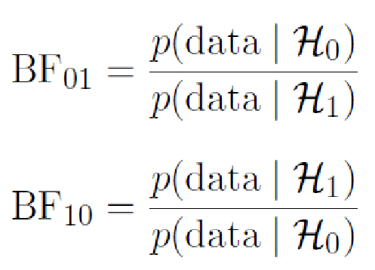
Recap Bayes factor
Two hypotheses H₀ and H₁
Observe data
Bayes factor is ratio between p(data | H₀) and p(data | H₁)
Notation:

Slide 32
Break

Slide 33


Slide 34
Personality of commandos
Big five: NEOAC
Literature inconsistent
Assignment is based on paper

Slide 35
Assignment
Do commandos differ from civilians on neuroticism?
Do commandos differ from civilians on extraversion?
These links can also be found in the assignments document on Nestor:
Website: https://rikhuijzer.github.io/BayesianAssignment.jl/
PDF: https://rikhuijzer.github.io/BayesianAssignment.jl/bayesian-assignment.pdf

Slide 36
Assignment
[2 pt] data cleaning
[2 pt] plots
[3 pt] frequentist tests with results section
[3 pt] Bayesian tests with results section
Write results sections. So, don't just copy-and-paste numbers.

Slide 37
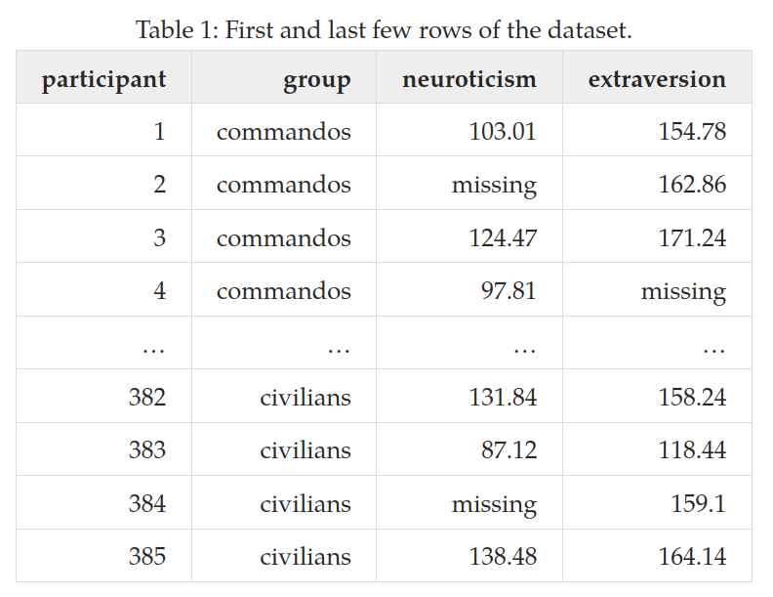

Slide 38
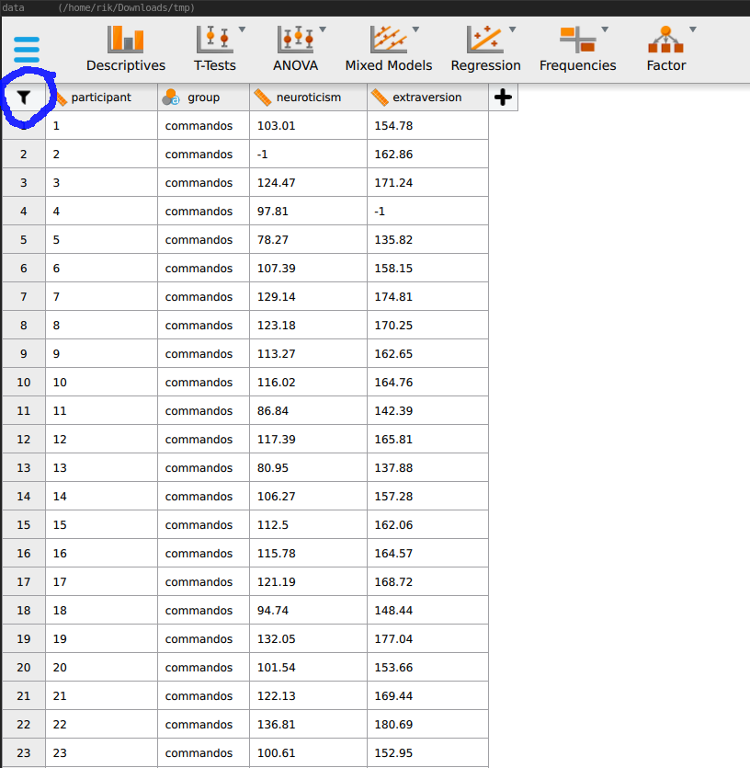

Slide 39
Logic operators
∧: AND
∨: OR
(2 < x) ∧ (x < 1) = ...
(x = 3) ∧ (x = 1) = …
(2 < x) ∨ (x < 1) = …
Also useful for searching literature (next slide)

Slide 40
Logic operators
Also useful for searching literature.
For example, via PsycInfo:
nurses AND (depression OR anxiety)
personality AND (military OR "special forces" OR aviators)
Beware that you get the brackets right:
personality AND military OR "special forces" OR aviators

Slide 41
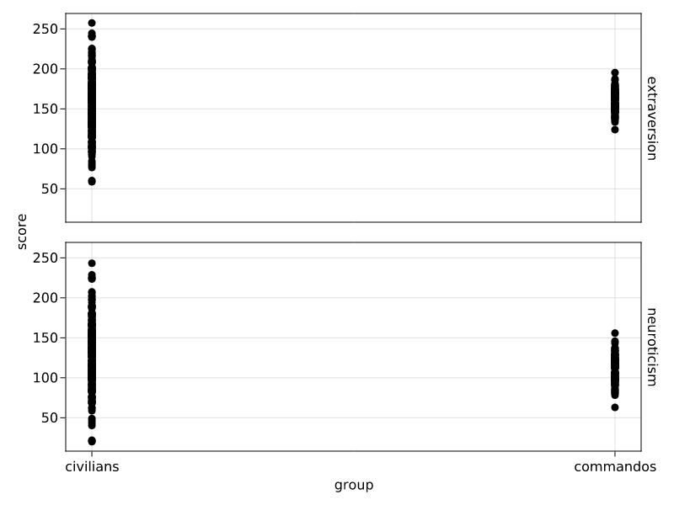

Slide 42
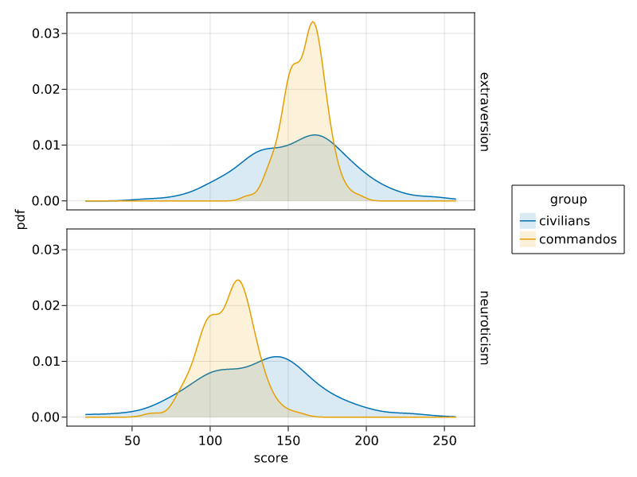

Slide 43
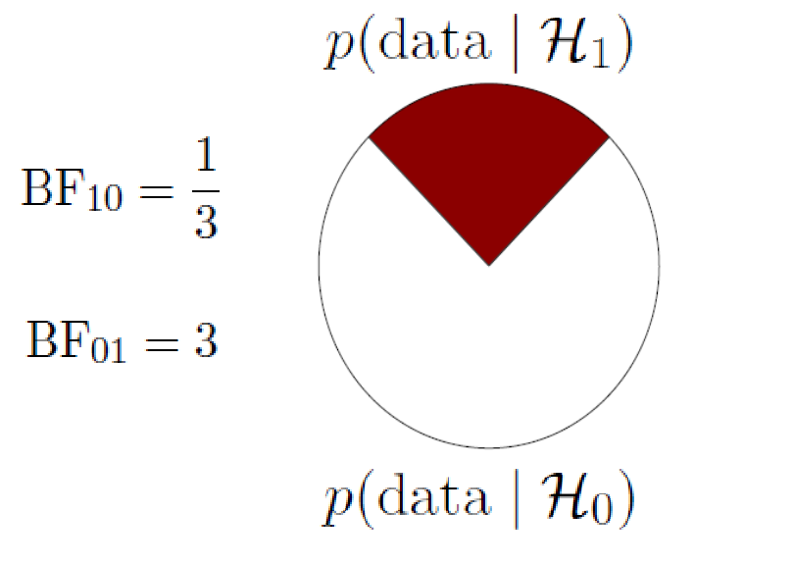
https://static.jasp-stats.org/presentations/ICPS2015/ICPS15EJ.pdf

Slide 44
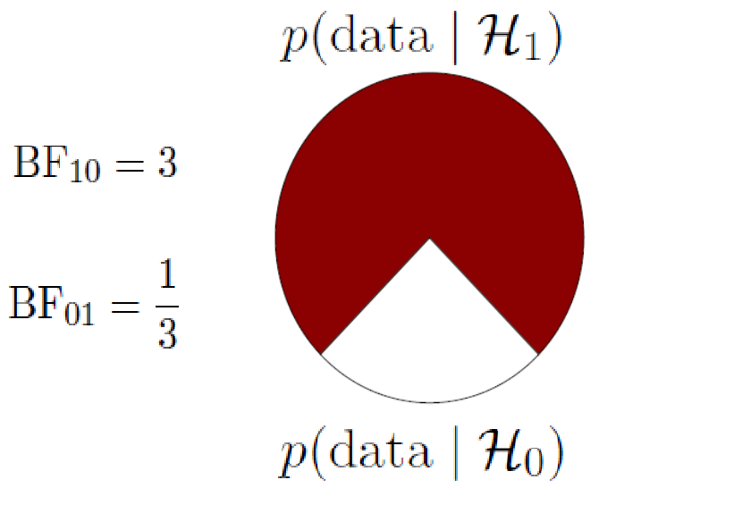

Slide 45
JASP questions?
Don't forget to check Google / Bing / Duckduckgo
There is a lot of material available online

Slide 46
Assignment grading
[2 pt] data cleaning
[2 pt] plots
[3 pt] traditional inference tests with results section
[3 pt] Bayesian tests with results section
Common-sense APA:
Give all figures and tables a name (number) and mention them in-text (so that we don't have to guess)
Explicitly mention which part of your report belongs to what question (so that we don't have to guess)

